Slide 1
FOSDEM 2012
Brussels, Belgium, February 4th, 2012
The OpenNebula Project
Carlos Martín Daniel Molina
Developers
Acknowledgments
The research leading to these results has received funding from the European Union's Seventh Framework Programme ([FP7/2007-2013] ) under grant agreement n° 261552 (StratusLab Project)
© OpenNebula Project. Creative Commons Attribution-NonCommercial-ShareAlike License
1/18

Slide 2
What is OpenNebula?
IaaS Cloud Computing Tool for Managing a Data Center's Virtual Infrastructure
Data Center Virtualization Manager
Open-source Apache license
Interoperable, based on standards
Adaptable
Private Clouds
Virtualize your on-premise infrastructure
Hybrid Clouds
Extend your private cloud with resources from a remote cloud provider
Pubic Clouds
Expose standard cloud interfaces
Ready for end-users
Advanced user management
CLI and Web Interface
Public User
Private User
Administrator
Remote Provider
Physical Infrastructure

Slide 3
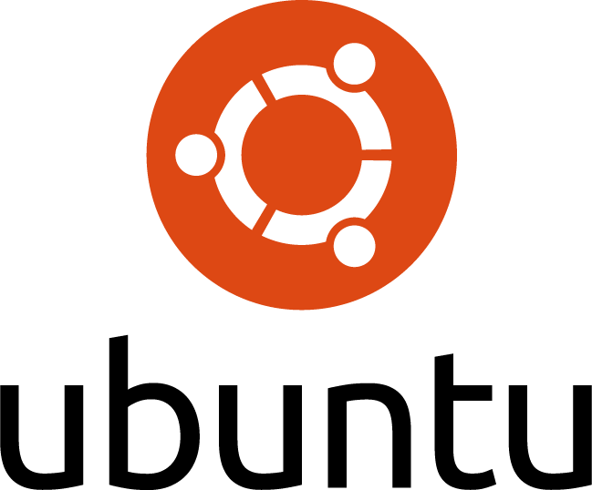
What is OpenNebula?
Building the Industry Standard Open Source Cloud Computing Tool
Develop & innovate
Support the community
Collaborate
Third party scalability tests: 16000 VMs
Commercial Support
TP
v1.0
v1.2
v1.4
v2.0
v2.2
V3.0
V3.2
2005
2008
2009
2010
2011
2012
dsa group doing research…
4,000 downloads/month
European Funding

Slide 4
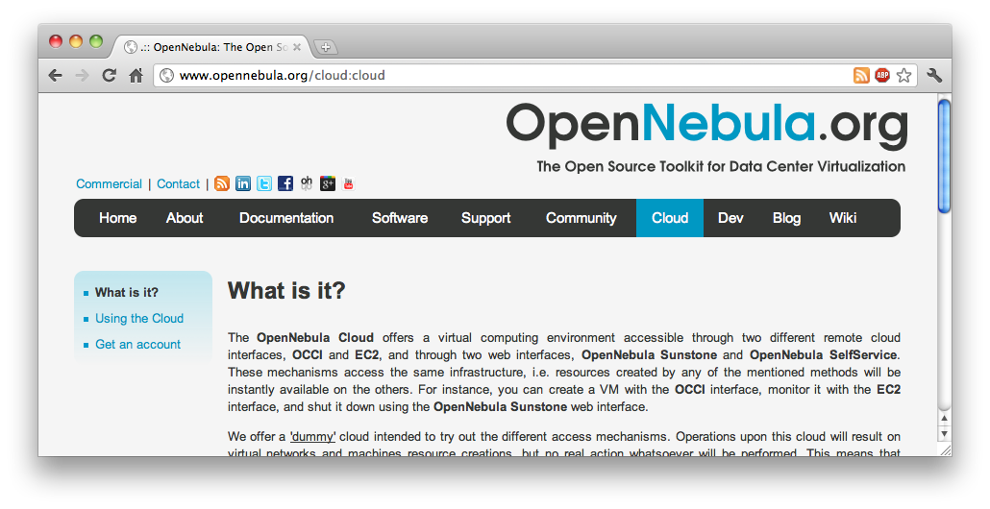
What is OpenNebula?
A Really Quick Demo
Let’s take a look at Sunstone!

Slide 5
CLI
GUI
Cloud Servers
Scheduler
OCA (Ruby, Java)
XML-RPC API
OpenNebula core
Monitoring
Internal
Ganglia
Storage
FS, Vmware
iSCSI, LVM
Network
802.1Q, ebtable
OpenvSwitch
VMware
DB
Sqlite
mysql
Virtualization
Xen
KVM
VMware
Hybrid
Amazon EC2
Auth
Internal, ssh
X509
ldap

Slide 6
The OpenNebula Architecture
How to Develop Drivers
Drivers
Small scripts for each action
Any language (Shell, Ruby…)
Different drivers can co-exist in heterogeneous environments
CLI
GUI
Cloud Servers
Scheduler
OCA (Ruby, Java)
XML-RPC API
OpenNebula core
Monitoring
Storage
Network
DB
Virtualization
Images
Auth
Easy to adapt
Easy to create new ones

Slide 7
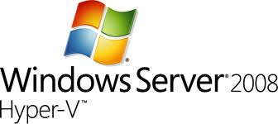
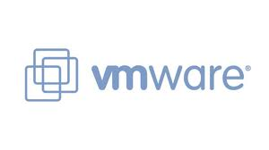
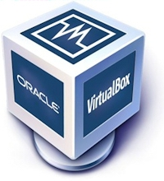
The OpenNebula Architecture
How to Develop Drivers
Virtualization Drivers
Translate the OpenNebula VM life-cycle management into specific hypervisor operations
Monitoring Drivers
Gather information about the physical host and hypervisor status
Hybrid Cloud Drivers
Interact with an external provider instead of a hypervisor
CLI
GUI
Cloud Servers
Scheduler
OCA (Ruby, Java)
XML-RPC API
OpenNebula core
Monitoring
Storage
Network
DB
Virtualization
Images
Auth
OpenNebula distribution
Community contributions

Slide 8
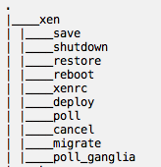
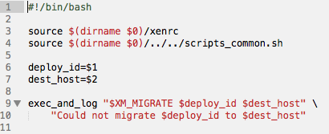
The OpenNebula Architecture
How to Develop Drivers
Virtualization Driver Example:
Hypervisor: Xen Action: migrate Description: live-migrates a running VM to the specified Host

Slide 9
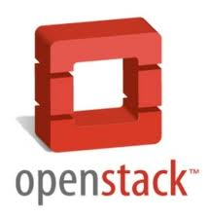
The OpenNebula Architecture
How to Develop Drivers
Image & Storage Drivers
Create or Import new Images into the Image Repository
File management between the Image Repository and the physical hosts
CLI
GUI
Cloud Servers
Scheduler
OCA (Ruby, Java)
XML-RPC API
OpenNebula core
Monitoring
Storage
Network
DB
Virtualization
Images
Auth
OpenNebula distribution
Shared FS
LVM
iSCSI
SSH
HTTP
Community contributions
scp-tsunami
MooseFS
CDMI API
Market Place
Swift/Glance

Slide 10
The OpenNebula Architecture
How to Develop Drivers
Networking drivers
Manage network configuration in the hosts
Firewalling rules
Network Isolation
Bridge creation
CLI
GUI
Cloud Servers
Scheduler
OCA (Ruby, Java)
XML-RPC API
OpenNebula core
Monitoring
Storage
Network
DB
Virtualization
Images
Auth
OpenNebula distribution
VLAN, 802.1Q
OpenvSwitch
ebtables
FLAT

Slide 11
The OpenNebula Architecture
How to Develop Drivers
Authentication drivers
Strong security
Flexibility
Authorization drivers
Add any limitations to the user actions
CLI
GUI
Cloud Servers
Scheduler
OCA (Ruby, Java)
XML-RPC API
OpenNebula core
Monitoring
Storage
Network
DB
Virtualization
Images
Auth
OpenNebula distribution
OpenNebula distribution
SSH Keypairs
x509 Certificates
LDAP
ACLs
Quotas
Community contributions

Slide 12
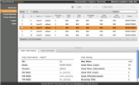
The OpenNebula Architecture
How to Interact with OpenNebula
XML-RPC
Simple, fast
Works in any language
OCA (OpenNebula Cloud API)
High level bindings
Complete functionality
Ruby, Java, Python
CLI
GUI
Cloud Servers
Scheduler
OCA (Ruby, Java)
XML-RPC API
OpenNebula core
Monitoring
Storage
Network
DB
Virtualization
Images
Auth
OpenNebula distribution
Community Contributions
Administrator GUI
User GUI
OCCI
OVF
Cloud APIs
CDMI

Slide 13
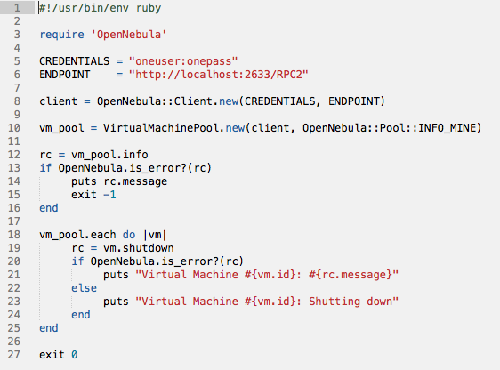
The OpenNebula Architecture
How to Interact with OpenNebula
OCA Ruby Example:
Shutdown all my Virtual Machines

Slide 14
So much more
Multi-tier Cloud Architecture
CloudFront
Portal
Cloud API (EC2, OCCI)
Global AuthN
User
OpenNebula Zone
OpenNebula Zone
Multi-tenancy
Runs Instances
Stores Images
Networking
Authorization
Multi-tier arch.
Scalable
Isolation
Multiple-site support

Slide 15
Join our growing community!
Organizations Building Clouds and Innovative Projects
Organizations Building Clouds for Development, Testing and Production
Projects Building an Open Cloud Ecosystem Around OpenNebula
16,000 VMs!

Slide 16
Join our growing community!
How to contribute
Join our mailing list
Follow the development at dev.opennebula.org
Ecosystem projects
OpenNebula hosts an ecosystem catalog
Promote and discuss ecosystem projects in our ecosystem mailing list
IRC Channel
#opennebula on irc.freenode.net

Slide 17
Questions?
We Will Be Happy to Answer any Question
@opennebula
The research leading to these results has received funding from the European Union's Seventh Framework Programme ([FP7/2007-2013] ) under grant agreement n° 261552 (StratusLab Project)

